Slide 1
Software Requirements Engineering
By
Abid Ali
BS Software Engineering
5th
Lecture #3

Slide 2
Agenda
The Expectation Gap . . . . . . . . . . . . . . . . . . .
Who Is The Customer? . . . . . . . . . . . . . . . . . .

Slide 3
The expectation gap
Without adequate customer involvement, the obvious outcome at the end of the project is an expectation gap, a gulf between what customers really need and what developers deliver based on what they heard at the beginning of the project (Wiegers 1996).
This is shown as the dashed lines in Figure 2-1.

Slide 4
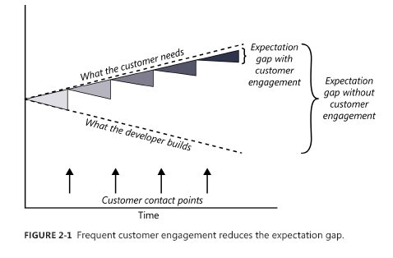
Cont..

Slide 5
Cont..
The best way to minimize the expectation gap is to arrange frequent contact points with suitable customer representatives.
These contact points can take the form of interviews, conversations, requirements reviews, user interface design walkthroughs, prototype evaluations, and—with agile development—user feedback on small increments of executable software.
Each contact point affords an opportunity to close the expectation gap: what the developer builds is more closely aligned with what the customer needs.

Slide 6
Who is the customer?
A stakeholder is a person, group, or organization that is actively involved in a project, is affected by its process or outcome, or can influence its process or outcome. Stakeholders can be internal or external to the project team and to the developing organization.
Figure 2-2 identifies many of the potential stakeholders in these categories. Not all of these will apply to every project or situation, of course.

Slide 7
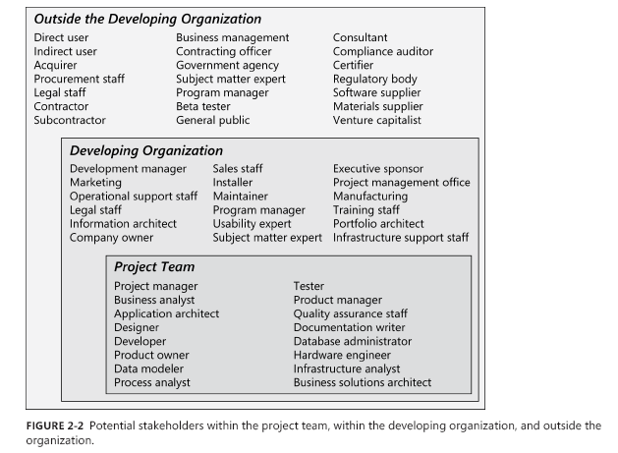

Slide 8
Cont..
Customers are a subset of stakeholders. A customer is an individual or organization that derives either direct or indirect benefit from a product.
Software customers could request, pay for, select, specify, use, or receive the output generated by a software product.
The customers shown in Figure 2-2 include the direct user, indirect user, executive sponsor, procurement staff, and acquirer.
Some stakeholders are not customers, such as legal staff, compliance auditors, suppliers, contractors, and venture capitalists.

Slide 9
Cont..
User requirements should come from people who will actually use the product, either directly or indirectly.
These users (often called end users) are a subset of customers.
Direct users will operate the product hands-on. Indirect users might receive outputs from the system without touching it themselves, such as a warehouse manager who receives an automatic report of daily warehouse activities by email.

Slide 10
Cont..
Users can describe the tasks they need to perform with the product, the outputs they need, and the quality characteristics they expect the product to exhibit.

Slide 11
The end
Thank you

